Slide 1
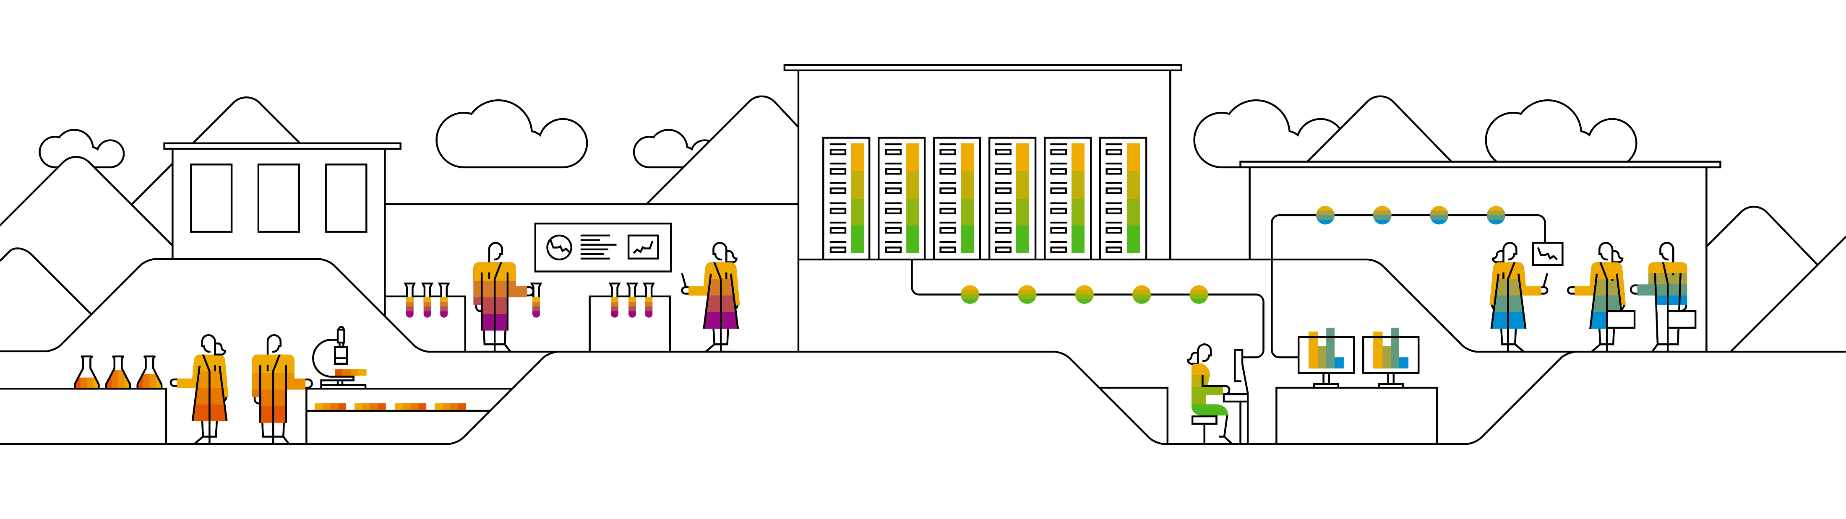
SAP Logistics Business Network An Introduction for API enabled Carriers
Product Management, SAP SE
October 2020

Slide 2




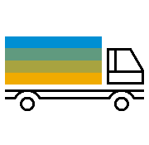











SAP Logistics Business Network Increased business speed through an always on, secure network of networks
Global
Onboard once – collaborate with many, anywhere and anytime
Allow different stake-holders to consume logistics services and share insights
Multi-party
Interoperable
Shippers
Freight Forwarders
Logistics
Business Network
Carriers
Other Networks
Freight Collaboration
Track and Trace
Suppliers
Capability
Global Track and Trace
Material Traceability
…
Customers
Connectivity & Platform
Intelligent Suite
Multi-modal
Robust, scalable cloud service with global coverage
Connect multiple business partners for inter-company collaboration and transparency
Standardized services for logistics collaboration and insights
2020 SAP SE or an SAP affiliate company. All rights reserved. | PUBLIC
2
Notes:
Onboard once - collaborate with many, anywhere and anytime. Break up siloed operations to manage freight more efficiently. Benefit from situational awareness and eased decision making through Track & trace

Slide 3


















SAP Logistics Business Network openness Extend the reach and accelerate innovation with established partner services
Carriers
Mode-specific / regional networks /
Shippers
B2B integration
Digital carrier networks
Instant pricing & subcontracting
SAP Logistics Business Network
Partner content & applications
Visibility networks
Expected time of arrival, milestone and geo- tracking in real-time
Multi-network and partner collaboration for end-to-end logistics execution
2020 SAP SE or an SAP affiliate company. All rights reserved. | PUBLIC
3

Slide 4
What can you as a carrier do on SAP Logistics Business Network?

Slide 5




SAP Logistics Business Network Scope*
Discover
Connect
Collaborate
Gain Insights
Become part of SAP trading partner directory and become discoverable for other network participants
Find trading partners and communities
Discover new business opportunities
Connect once, and offer your services to all members of SAP Logistics Business Network through this single account (no more log on to various customer portals)
Logistics business partners anytime, anywhere
Any device, back-end system and level of technical ability
Through inter-company and transparency scenarios
Multi-modal, globally and seamlessly
Through real-time alerts and notifications
With analytics and benchmarking
* Feature coverage as per roadmap

Slide 6










Freight Order Collaboration End-to-end collaboration for LTL + FTL shipments with your customers*
WebUI + API
WebUI **
WebUI + API
WebUI **
Order Management
Slot Booking
Execution
Settlement
Quotation processing and order confirmation
Appointment booking for pick-up or delivery of goods
Milestone and ETA reporting, as well as document exchange, such as proof of delivery
Self billing, invoicing and dispute management
* The scope depends on your customers and for which processes they leverage SAP LBN for collaboration with you
** API enablement planned
Collaborative
processes
Digital freight
documents
Real-time
insights
Out-of-the-box
integration
2020 SAP SE or an SAP affiliate company. All rights reserved. | PUBLIC
6

Slide 7

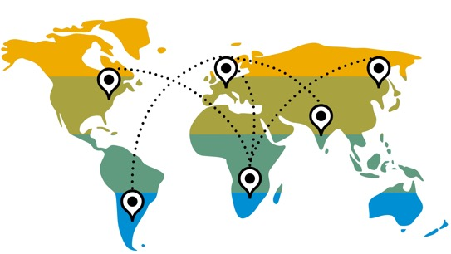









Standardized Multi-Mode Visibility for your Shipments*
Provide visibility to your customers on the execution of their ocean transportation shipments:
Booking & container tracking with milestones/actual events and geo location at sea
Container Terminal
at Port of Origin
Port of Origin
Transshipment Port
Port of Discharge
Container Terminal at Port of Discharge
Consignee Location
Empty container dispatched for loading
Container received
Container loaded
Vessel departed
Vessel arrived
Container unloaded
Container loaded
Vessel departed
Geo location
Vessel arrived
Container unloaded
Container out for delivery
Empty container returned
Container delivered
* current coverage is for road/ocean movements; further transportation modes as per roadmap

Slide 8
How can you join SAP Logistics Business Network?

Slide 9
SAP Logistics Business Network Typical customer (shipper/freight forwarder) driven onboarding process
1. Shipper Engagement
2. Carrier Engagement
3. Sign up & Provisioning
5. API Integration*
4. Customer Connection & Enablement
6. Ongoing Support
Your customer (shipper/freight forwarder) engages with SAP LBN and identifies you as one of their key partners they would like to collaborate with via SAP LBN
Your customer invites you to join SAP LBN; SAP follows up and provides service overview to you (low-touch email) on behalf of your customer
You receive an invitation e-mail and sign-up for SAP LBN. SAP supports registration and account configuration
SAP assists in finalizing connection with your customer. SAP provides documentation on how to leverage SAP LBN and how to get started
SAP provides comprehensive API integration self-service and API documentation, based on which you create a mapping from/to your own APIs
Project review and health check; ongoing support by SAP
SAP Supply Chain Network Team (Enablement and Onboarding)
Your customer
Your customer
Carrier
* this step only applies if you prefer electronic integration between SAP LBN and your own Transportation Management System – if you prefer to use SAP LBN provided web applications only, there is no need for setting up an API integration (please note, that a hybrid approach is possible in which you leverage web applications for some processes, while you set up electronic integration for others). In case you would like to get assistance with the integration efforts, SAP can point you to related service offerings.

Slide 10
Are there costs involved?

Slide 11
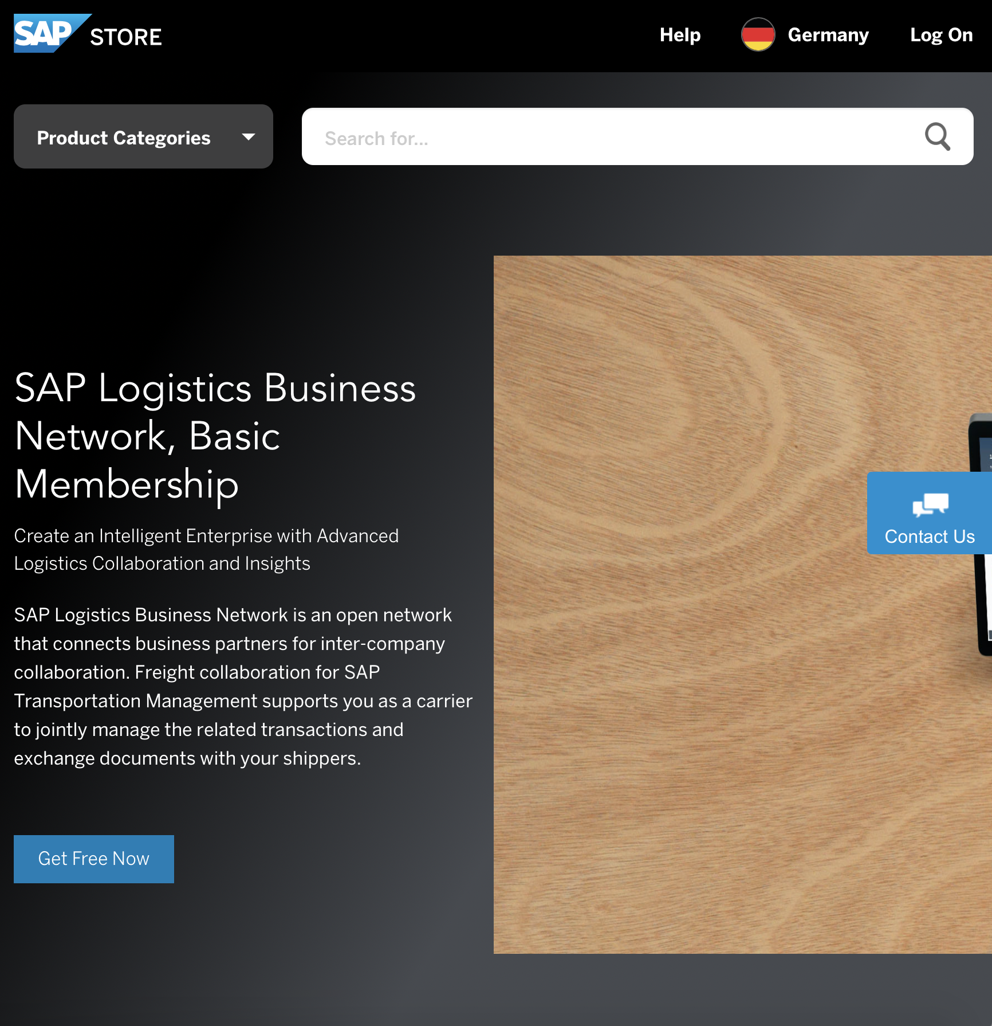
Basic Membership
As a carrier (or freight forwarder in a “carrier”-like role), signing-up to SAP Logistics Business Network for receiving your customers transport orders for confirmation, event reporting, invoice submission and booking slots is free of charge*!
If you are a carrier or freight forwarder and would like to use SAP Logistics Business Network not only to receive transport orders from your own customers (in a “carrier”-like role), but want to leverage the network also to collaborate on your own planned transport orders with your own carrier network (more in a “shipper”-like role) by integrating with your own SAP Transportation Management back-end, please reach out to your local SAP Account Team to request an offer for a separate SAP Logistics Business Network, freight collaboration option license (license costs apply).
* referring to the scope highlighted in the previous slides

Slide 12
Further Information

Slide 13
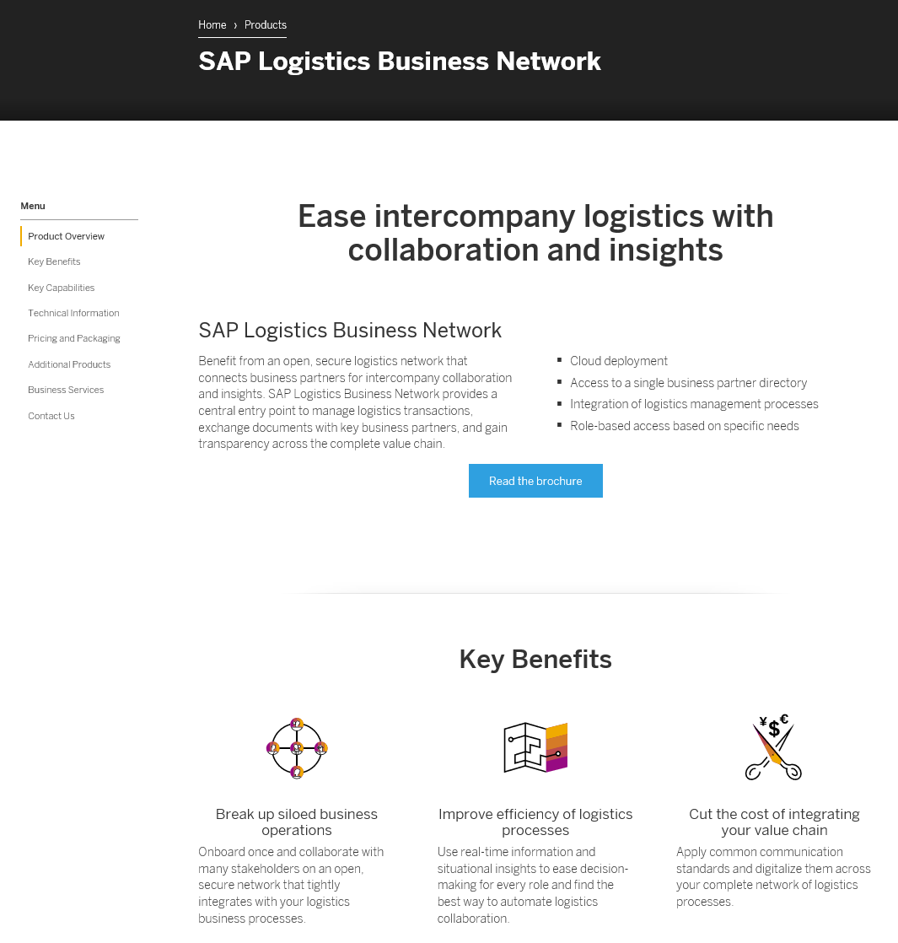
Where to find more information
API Self-Service
SAP.COM
SAP Store
Help Portal

Slide 14
Thank you.
Contact information:
LBN@SAP.COM

